Slide 1


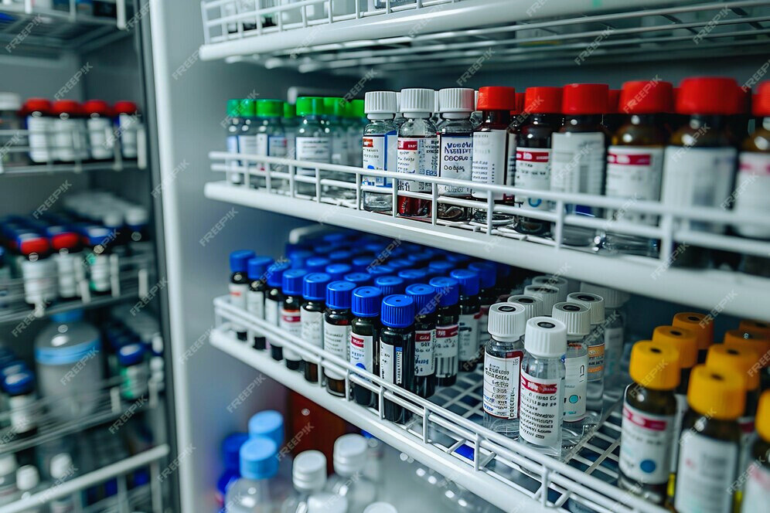
SWE 4304
PHARMA
SYNC
Presented by :
Ahnaf Shahriar Pias ( 220042146 )
Md. Sameur Rahman ( 220042144 )
Irfan Shafee ( 220042164 )
===================================

Slide 2
PROJECT OVERVIEW
--> Enables efficient management of medicine inventories with detailed information
--> Supports sorting and filtering while viewing medicines.
--> reporting features that alert about expiring medicines and low stock levels
--> Ensures that the pharmacy remains well-stocked

Slide 3


KEY
FEATURES
View Medicine
Stock Manipulation
1
1
Add Medicine
Search
2
Sort
2
Update
Name
Price
Generic Name
Quantity
Expiry Date
3
Delete
Quantity
3
Filter
Quantity
Supplier

Slide 4

KEY
FEATURES
Sell Medicine
Notification
1
Add items to cart
1
Notification for expiry
2
Show Subtotal
2
Notification for low stock
3
Print Recipt
4
Automated Stock Reduction
Future Scope
*
Selling Trends
*
Supplier Rating

Slide 5





Tools & Technologies

Slide 6
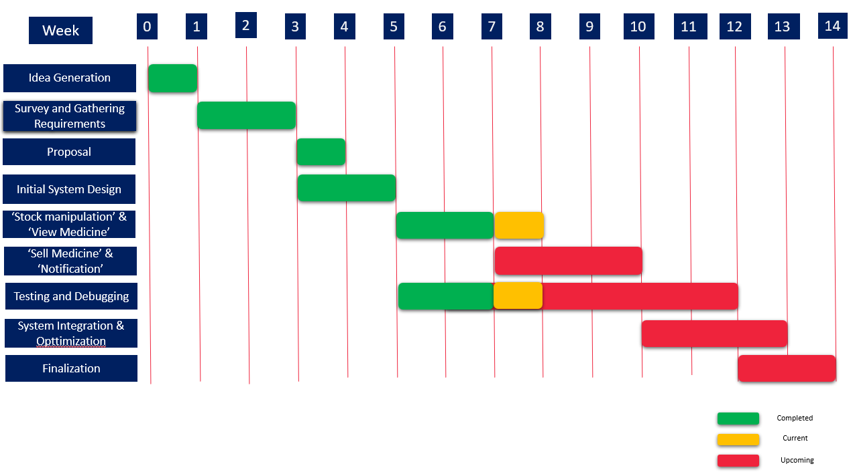
Project Timeline

Slide 7
== DEMO ==

Slide 8
==* THANK YOU *==

